Slide 1
Data structures in python
Dr. Ahmad Altarawneh

Slide 2
Outline
Why data structures
Lists
Nested lists
Tuples
Sets
Dictionaries

Slide 3
Why data structures
Data structures is a fundamental topic in computer science
Data structures allow data to be organized, managed, and stored in a way that facilitates efficient access and modification.
Python offers a variety of built-in data structures.
Lists
Tuples
Dictionaries
Sets

Slide 4
Lists in python
A python list is a mutable collection that allows you to store, manipulate data
Lists can store different data types
Items in the list have a defined locations (indices)
Items can be accessed using their index value
Syntax
names = [ 'Sami', "Batool", "Ahmad"]
data = [ ] # syntax of creating an empty list
values = list([1,2,4,5]) # explicitly using the list constructor

Slide 5
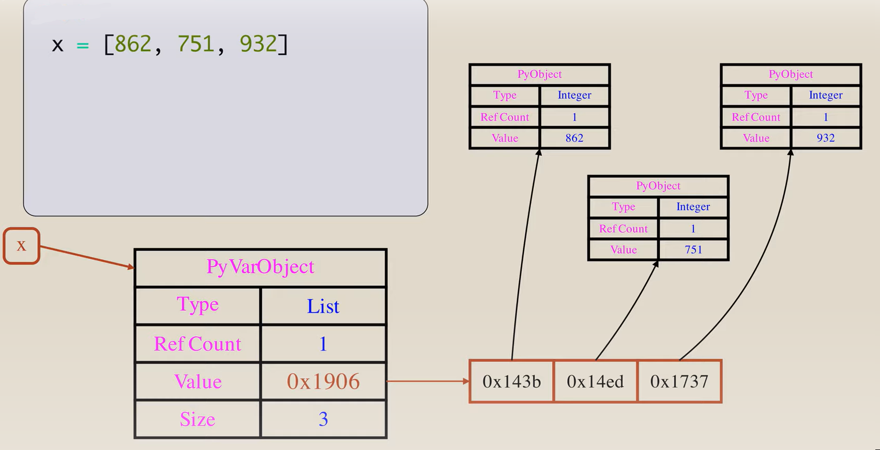

Slide 6
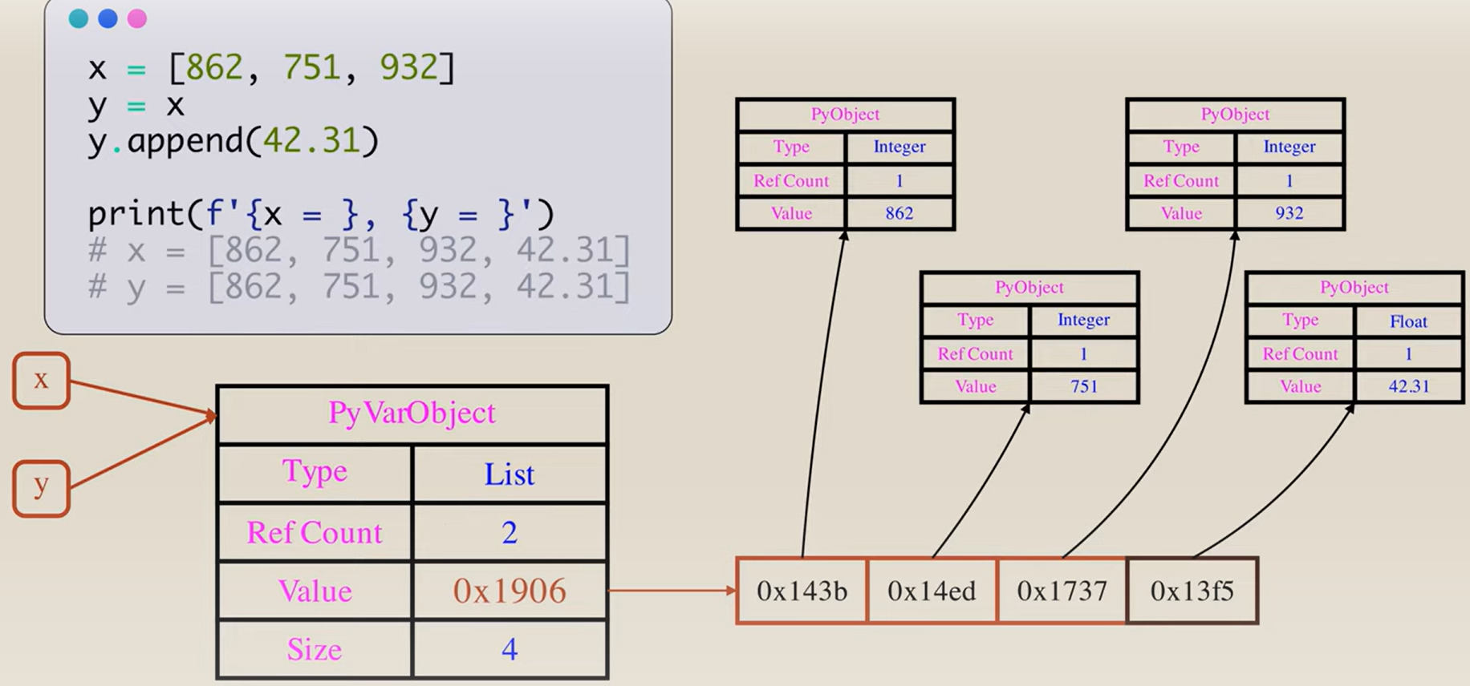
mutability
Python list is a mutable object: it can be changed and modified after its creation.
Try
print(id(x),id(y))

Slide 7
Example
Create an empty list and fill it with 5 random numbers and print them in a separate for loop (using for each, and using range function)
listname[index] is used to access the elements by their index value
using print(listname) will print the list without loops
import random
lst = []
for i in range(5):
lst.append(random.randint(0,100))
for i in lst:
print(i)
for i in range(len(lst)):
print(lst[i])

Slide 8
Example 2
Create a list called prices and fill it with 10 random number between 10 and 100, as a representation of prices of 10 items
Create another list called reduced_prices and fill it with the prices in the prices list after applying 10% discount on them
import random
prices = []
for i in range(5):
prices.append(random.randint(10,100))
reduced_prices =[] for i in prices:
reduced_prices.append(i*0.9)

Slide 9
List slicing
One can extract a slice from a python list using the following syntax
list_name[S:E]
[0 1 2 3 4 5 6 7 8 9]
values = [10, 11, 12, 13, 14, 15, 16, 17, 18, 19]
values[4:8]
The result =>
[14, 15, 16, 17]
The last index in the slice is not included in the results

Slide 10
More slicing options
lst = [0, 1, 2, 3, 4, 5, 6, 7, 8, 9]
Slicing with Step: lst[start:stop:step]
Slicing omitting start: lst[:end]
Slicing omitting end: lst[start:]
Slicing omitting start and end: lst[::step]
Slicing with step: lst[::-step]
Slicing with negative indices: lst[-4:-2] Output: [6, 7]
Negative indices means starting from the end of the list
lst[2:8:2] Output: [2, 4, 6]
lst[::-1]
This syntax means omitting the start and end with a negative step
REVERSES THE LIST
lst[:2] Output: [0, 1]
lst[5:] Output: [5, 6, 7, 8, 9]
lst[::2] Output: [0, 2, 4, 6, 8]
lst[::-2] Output: [9, 7, 5, 3, 1]

Slide 11
List with operators
Different lists can be concatenated together using the + operator
A list can be repeated using the * operator
Useful when creating uniform list (e.g., list of zeros or ones)
lst1 = [1,2,5,6]
lst2 = ['A','B']
print(lst1 + lst2)
lst1 = [1,2,5,6]
lst2 = ['A','B'] lst1 += lst2
lst1 = [1]*10
lst2 = ['A','B']*5

Slide 12
List methods
append(element): Adds an element to the end.
extend(list): Adds multiple elements.
insert(index, element): Inserts an element at a specific position.
remove(element): Removes a specific element.
pop(index): Removes and return an element at a specific index.
index(element): Finds the index of an element.
count(element): Counts occurrences of an element.
sort(): Sorts the list.
reverse(): Reverses the list.
copy(): Returns a shallow copy of the list.

Slide 13
Example
lst = [4,3,8,4,33]
lst.append(10)
[4, 3, 8, 4, 33, 10]
lst.extend([20,30,40])
[4, 3, 8, 4, 33, 20, 30, 40]
lst.insert(1,80)
[4, 80, 3, 8, 4, 33]
lst.remove(4)
[3, 8, 4, 33]
lst.pop(2)
[4, 3, 4, 33]
lst.index(8)
2
lst.count(4)
2
lst.sort()
[3, 4, 4, 8, 33]
lst.reverse()
[33, 4, 8, 3, 4]

Slide 14
Nested lists
Lists are entities can store any objects, including other lists
One can traverse a list of lists using nested loops
lsts = [[0,1,2],['A','B']]
for lst in lsts:
for item in lst:
print(item)
lst = [[1,2,5,8],[6,30,4,20],[1,'B']] for i in range(len(lst)):
for j in range(len(lst[i])):
print(lst[i][j])

Slide 15
Shallow copy vs deep copy
A shallow copy creates a new object but does not create copies of the objects contained within it.
A deep copy creates a new object and then, recursively, inserts copies of all objects found in the original.
This means a deep copy duplicates everything.
Useful when you want to clone an object along with all of the objects it refers to, recursively, creating an entirely independent object tree

Slide 16
Examples
lst2 = lst1[:]
lst1 = [4,3,8,4,33]
lst2 = lst1
lst1.append(1)
print(lst1)
print(lst2)
lst1 = [4,3,8,4,33]
lst2 = lst1.copy()
lst1.append(1)
print(lst1)
print(lst2)
[4, 3, 8, 4, 33, 1]
[4, 3, 8, 4, 33, 1]
[4, 3, 8, 4, 33, 1]
[4, 3, 8, 4, 33]
Important note
The copy method perform 1 level copy
this wont work with nested lists.
The internal lists still refer to the same locations
To duplicate everything a deep copy is needed
lst1 = [[0,1,2],[3,6,8]]
lst2 = lst1.copy()
lst1[0][0] = 5
print(lst1)
print(lst2)
import copy
lst1 = [[0,1,2],[3,6,8]]
lst2 = copy.deepcopy(lst1)
lst1[0][0] = 5
print(lst1)
print(lst2)
[[5, 1, 2], [3, 6, 8]]
[[5, 1, 2], [3, 6, 8]]
[[5, 1, 2], [3, 6, 8]]
[[0, 1, 2], [3, 6, 8]]

Slide 17
List comprehension
List comprehensions provide a concise way to create lists in Python.
The syntax is designed to reflect the notation one might use in mathematics.
Since list comprehensions produce a new list, they don't modify existing lists.
This can be seen as a benefit in scenarios where immutability is desired
For complex operations, traditional loops might be clearer
[expression for item in iterable if condition]
[expression if condition else expression for item in iterable]

Slide 18
Examples
using list comprehension, multiply each element in the following list by 2
Solution:
Same as above, but add a condition: multiply when the number is > 5
[2,5,6,8,7,4]
lst = [2,5,6,8,7,4]
result = [x*2 for x in lst]
print(result)
[4, 10, 12, 16, 14, 8]
lst = [2,5,6,8,7,4]
result = [x*2 for x in lst if x >5]
print(result)
[12, 16, 14]

Slide 19
Exercises
Given a list of words, create a new list containing each word's length.
Assume that you have two lists, one for items and another for indices, as follows:
Return a list that contains the elements at the locations in the idx list
Flatten the following list of lists using list comprehension
List of logical values (True, False), if the value is > 5 True otherwise False
lst = ['Hi','number', 'introduction']
lst = [2,5,6,8,7,4]
idx = [1,3,5]
lst = [[1,2,5,8],[6,30,4,20],[1,4]]
lst = [1,6,9,8,7,1,5]
Rework it as: If the value is > 5 add 10 otherwise make it zero

Slide 20
any() and all()
any() and all() are built-in Python functions that operate on iterables, such as lists.
They are used to test whether any or all elements of an iterable meet a certain condition
Example: check if the elements in the following list are positives
Check if any of the strings in the following list is empty
lst = [1,5,9,22,30]
result = all([x>0 for x in lst])
print(result)
lst = ["Mutah", "AB", "Jordan" ,""] result = any([len(x)==0 for x in lst]) print(result)

Slide 21
zip and enumerate
The zip() function takes two or more iterables (like lists) and returns an iterator that generates tuples containing elements from the input iterables, paired element-wise.
Can be used safely when the iterables are of different lengths
The enumerate() provides automatic enumeration of elements in an iterable (e.g., list)
Example: combine the letters with their numerical order
('A', 1)
('B', 2)
('C', 3)
('D', 4)
('E', 5)
letters = ['A','B','C','D','E']
numbers = [1,2,3,4,5]
result = zip(letters, numbers)
for i in result:
print(i)

Slide 22
Example 2
Use range function to provide indices for the items in the letters list
Using enumerate
(0, 'A')
(1, 'B')
(2, 'C')
(3, 'D')
(4, 'E')
letters = ['A','B','C','D','E']
for i in zip(range(len(letters)),letters):
print(i)
letters = ['A','B','C','D','E']
for i in enumerate(letters):
print(i) #i[0] prints the indices
(0, 'A')
(1, 'B')
(2, 'C')
(3, 'D')
(4, 'E')
enumerate(letters,S) => makes the enumerator starts from S

Slide 23
Tuples

Slide 24
Tuples
Tuples are similar to lists, i.e., can hold multiple elements in one entity
Tuples can be created by passing elements inside parenthesis ()
One can create nested tuples
Tuples are immutable datatype: cannot be modified or changed
The above statement will rise an error
t = (1, 2, 3, 4, 5)
t = tuple([1, 2, 3, 4, 5])
t[0] = 1
TypeError: 'tuple' object does not support item assignment

Slide 25
Operations on tuples
Tuples support few operations on them, due to their immutability property
Accessing elements: done by passing index inside a squared brackets
Concatenation: You can combine two tuples:
Repetition: You can repeat tuple to create concatenated multiple copies of the tuple
t = (1,2,3)
print(t[1])
=> 2
t1 = (1, 2, 3)
t2 = (4, 5, 6)
print(t1 + t2)
=> (1, 2, 3, 4, 5, 6)
t = (1, 2, 3)
print(t * 3)
=> (1, 2, 3, 1, 2, 3, 1, 2, 3)

Slide 26
Methods
Tuples have a limited number of methods
index(value): returns the index of the first appearance of a value
If the value does not exist it will rise a value error
count(value): returns the number of occurrences of a value in the tuple
If the value does not exist it will return 0
t = (1, 2, 3, 3,1)
t.index(1) => 0
t = (1, 2, 3, 3,1)
t.count(1) => 2

Slide 27
Packing and Unpacking
Values in a tuple can be unpacked by assigning it to number of variables equal to the number of items in the tuple
If one does not want to unpack an element from the tuple, its variable location can be replaced with _, it is a python convention which means do not care
t = ('Basem', 500, 22) name,salary, age = t print(name,salary, age)
t = ('Basem', 500, 22) name,_, age = t print(name, age)

Slide 28
Dictionaries

Slide 29
Dictionaries
Dictionaries or dict are one of the fundamental data types in Python.
They allow you to store and manage data as key-value pairs
Syntax: a dictionary can be created using { }
or using the dict method
When using this syntax you should write a valid identifiers (variable names) as a keys
we can pass a list of tuples to create a dictionary
dict1 = {'key1': 'value1', 'key2': 'value2'}
dict2 = dict(key1='value1', key2='value2')
a = dict([('a',4),(3,8)])

Slide 30
Accessing elements
In dictionary, the values can be retrieved by passing the corresponding key inside [ ]
Example
If the key does not exist => KeyError: key
Use the get method, to avoid any run-time errors
info = {10: 120, 20:250, 30: 540} print(info[10]) => 120
info = {10: 120, 20:250, 30: 540}
print(info.get(100, 'Not found'))
Not found

Slide 31
Modification
Dictionaries are mutable objects: can be changed and modified
You can add
Note: during the assignment, if the key exists its value will be replaced. Otherwise, a new key : value pair will be created
info = {10: 120, 20:250, 30: 540} print(info[10]) => 120 info[10]=200 print(info[10]) => 200
info = {10: 120, 20:250, 30: 540} print(info)
info[40]= 200
print(info)

Slide 32
Methods
There are some useful methods which can be used when dealing with dicts
keys(): Returns a view of all keys in the dictionary.
values(): Returns a view of all values in the dictionary.
items(): Returns a view of all key-value pairs in the dictionary.
pop(key,[default]): Removes and returns the value for the given key. If not found, default
clear(): Removes all key-value pairs from the dictionary.
products = {1925:"Rice" , 1368:"Juice", 5043:"Banana"}
dict_keys([1925, 1368, 5043])
dict_values(['Rice', 'Juice', 'Banana'])
dict_items([(1925, 'Rice'), (1368, 'Juice'), (5043, 'Banana')])
One can use the del function to delete a key from the dict

Slide 33
Iterating over a dictionary
Like lists, we can use loops to iterate over a dictionary
products = {1925:"Rice" , 1368:"Juice", 5043:"Banana"}
1925
1368
5043
for key in products:
print(key)
Rice
Juice
Banana
for value in products.values():
print(value)
(1925, 'Rice')
(1368, 'Juice')
(5043, 'Banana')
for item in products.items():
print(item)

Slide 34
Dictionary comprehension
Comprehension can be used with dictionaries same as lists
Example:
Combine the following two lists into one dictionary
keys = [1, 5, 9, 7, 10, 50]
values = ['AB', 'BC', 'DE', 'AA', 'BB', 'DD']

Slide 35
Practice
Assume you have the following dict of the student marks
Calculate the average mark for each course using traditional loop
Calculate the avg and put these averages in a list using list comprehension
Use a dict comprehension to calculate the average and track the course name
Make use of the zip method
do not use the zip method
Add 1 mark to all students in the python class
courses =
{"python":[60,70,90,50],"C++":[81,67,94],"Java":[68,72,86]}

Slide 36
Nested dictionaries
Recall that we can have list of lists. Also, we can have dictionary of dictionaries
You can access elements in different hierarchy levels by using the keys
Employees = {
12: {'name': 'Ahmad', 'age': 33},
340: {'name': 'Nadeem', 'age': 45},
560: {'name': 'Tamer', 'age': 52, 'Salary': 560}
}
name_value = Employees[12]['name']
print(name_value)
Ahmad

Slide 37
A bit complex scenario
Employees = {
12: {
'name': 'Ahmad',
'age': 33,
'courses': {
101: 'Python',
102: 'JavaScript'
}
},
340: {
'name': 'Nadeem',
'age': 45,
'courses': {
103: 'Java',
104: 'C++'
}
},
560: {
'name': 'Tamer',
'age': 52,
'salary': 560,
'courses': {
105: 'Go',
101: 'Python'
}
}
}
courses_info = Employees[12]['courses']
print(courses_info)
{101: 'Python', 102: 'JavaScript'}

Slide 38
Python sets

Slide 39
Sets
Set is a mutable collection used to store values in an unordered, and unindexed fashion
Sets do not allow duplicate values
Set items are passed inside {}
Example:
set1 = {"A", "B", "C"}
print(set1)
{'B', 'C', 'A'}
set2 = {"A", "B", "C","A","B"}
print(set2)
{'B', 'C', 'A'}

Slide 40
Cont.
Sets are useful to work with, when dealing with set operations like intersection and union
has built-in methods for these operations
Can be used for duplication removal
Sets are faster in membership operations: find if a value is a member of a set

Slide 41
Loop over a set
A Set is an iterable object and its elements can be visited using loops
User1 = {"Amani", "Basel", "Karam","Jawad","Layla"}
for friend in User1:
print(friend)
Jawad
Layla
Amani
Karam
Basel

Slide 42
Useful methods
Various methods can be used when working with sets
add(element): adds an element to the set
remove(element): removes an element from the set
update(other): updates the set with elements from another set
a.intersection(b): finds the mutual elements in both sets a and b
a.difference(b): returns a new set with the items in a but not in b
a.issubset(b): returns True if all elements of a are present in b
a.isdisjoint(d): returns True if the set a has no elements in common with the set b.

Slide 43
Example
Assume that you are building a social media site, and you want a way to find the mutual friends between two people
What if you want to make a friendship suggestion to User1?
User1 = {"Amani", "Basel", "Karam","Jawad","Layla"}
User2 = {"Jawad", "Monther", "Basel","Ahmad","Mahmoud"}
User1.intersection(User2)
{'Basel', 'Jawad'}

Slide 44
Exercise
use sets to remove duplicates from the following list
my_list = [1,5 ,4 ,5 ,5 , 2, 2, 3, 4, 4, 5]

Slide 45
Built-in functions
There are some built-in functions that can be used with iterable objects, like lists, tuples and dictionaries
max(iterable)
min(iterable)
sum(iterable)
len(iterable)
in: check if the element in the iterable object (true if the element in the iterable)
not in: in: check if the element is not in the iterable object (true if the element is not in the iterable)

